Slide 1
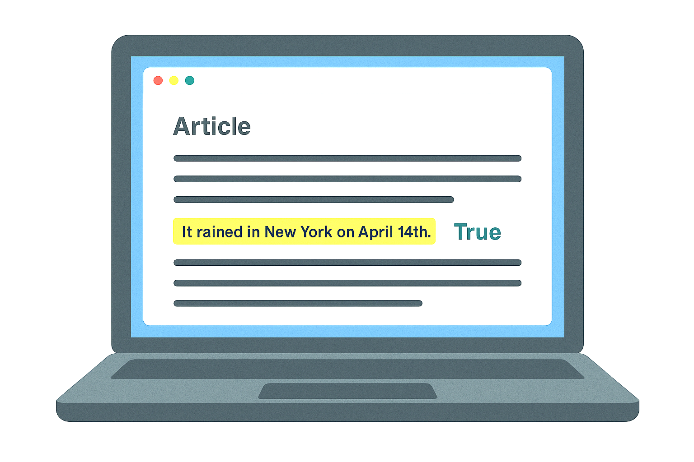
MythBuster.AI
One click to certainty
Group 1
Hiba Khan
Trent Blatz
Abhishek Dharmendra Rawal
Cade Lanzafame
Fahad Alhussain
Kunal Pingale
Shivani Sawant
MIE 671, Nehal Patel
2025
Notes:
Goodafternoon. This is group 1 and I am Hiba, ………………………….,
I am excited to introduce you to our product- Mythbuster.AI, a smart fact-checking and deepfake detection tool that brings you certainty, in just one click.

Slide 2
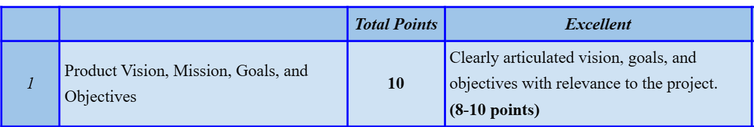
MythBuster.AI: AI-Powered Deepfake Detection – Real-Time Media Authentication
PRODUCT VISION
To establish MythBuster.AI as the global standard for real-time media authentication, ensuring that digital content remains authentic, objective, and trustworthy, thereby combating misinformation and protecting individuals, organizations, and society.
PRODUCT MISSION
MythBuster.AI empowers users with real-time deepfake detection using advanced AI and forensic tools. Designed for journalists, creators, and the public, it verifies videos, images, and audio instantly—stopping misinformation before it spreads.
Notes:
In today’s world, where information spreads faster than ever, where anyone can publish content on platforms like YouTube, Instagram —often with just a tap on our mobile screens—it’s critical to know: Is what I’m reading actually true?
MythBuster.AI empowers users to validate any kind of news, be it a blog or a video, instantly.
Our product is also an AI-Powered Deepfake Detection Tool that enables real-time media authentication by analyzing videos, images, and voice recordings to detect manipulations. It leverages machine learning and AI-driven forensic techniques to assess digital content instantly. Thus fr eg, if a celebrity meets with an accident, not only will Mythbuster.Ai tell yo if the news is true or not, but would also check for the AI created images and let you know if they are true or not.
This tool could be used by anyone from journalists to fact-checkers but most importantly to the general public. It helps control the spread of Misleading content as it can sway public opinion, distort reality, and even incite unrest.

Slide 3
GOALS AND OBJECTIVES
Our team aims to tackle the growing threats posed by deepfake technology and generative content, including:
✔ Misinformation & Fake News
✔ Ensuring Content Authenticity in Political & Religious Discourse
✔ Preventing the Spread of Misleading Information by Content Creators
✔ Reputation Damage
✔ Fraud & Security Threats
✔ Lack of Real-Time Verification
Notes:
This slides shows our problem. As mentioned in our vision, we authenticate the media you receive by addressing:

Slide 4
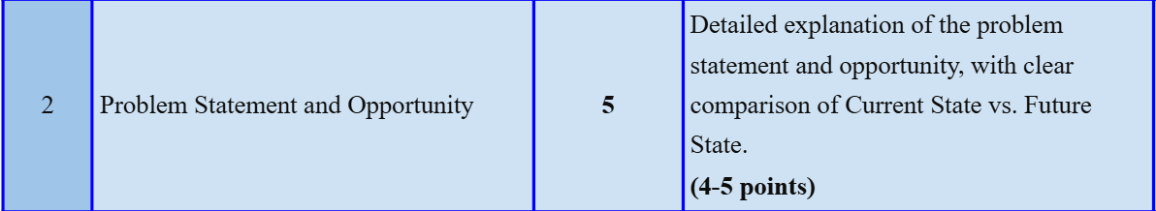
PROBLEM STATEMENT & OPPORTUNITY (current vs future state)
CURRENT REALITY | WITH MythBuster.AI
Deepfakes & AI-generated content are increasingly indistinguishable from real media. | Real-time detection of manipulated videos, images, and audio using AI-powered forensic tools.
Misinformation, political propaganda, and fake news spread rapidly on social platforms. | Authentic, verified content helps reduce manipulation and rebuild public trust.
No easy, accessible solution exists to verify content—especially in real time. | One-click verification for journalists, fact-checkers, governments, and the public
Public confusion and reputational damage caused by manipulated content. | Transparency and trust restored in the digital ecosystem with clear source references and accuracy indicators.
Notes:
This shows the current state of things vs the future state of media with MythBuster.AI.along the lines of what we discussed the previous slides.
Our products opportunity is that as AI-generated content grows, the demand for trustworthy, instant verification will only increase.
MythBuster.AI is not just a solution—it's a necessary evolution in digital truthkeeping.

Slide 5
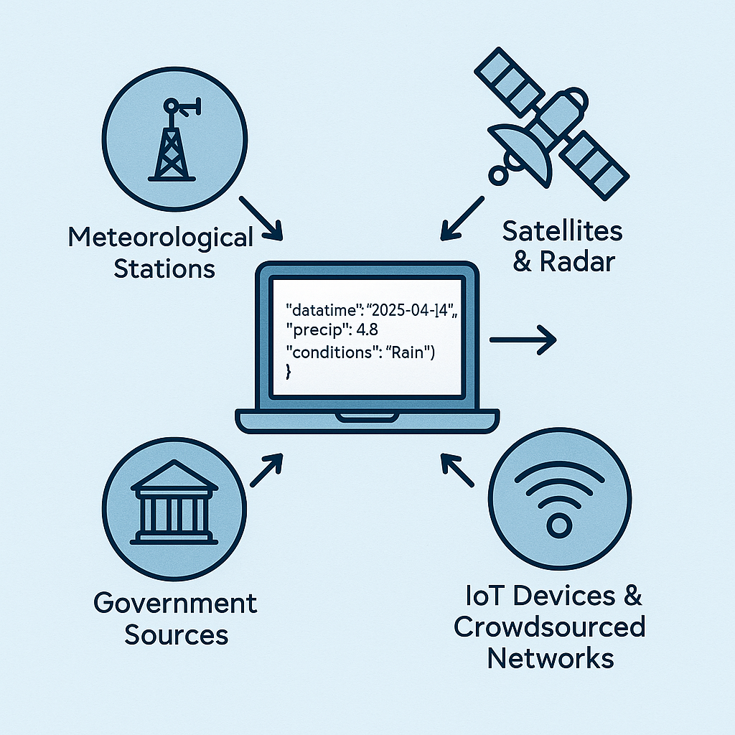
THE TECH AND DEMO
APIs are purchased from verified local and national media houses (e.g., The New York Times, AP, local weather services).
The API instantly pulls data relevant to the user's query or highlighted statement (e.g., weather records, political facts).
Statements are matched against trusted sources to determine accuracy: True, False, or Opinion
Multiple APIs allow expansion from regional (e.g., New York, Washington) to national and global coverage.
The product auto-detects content type and activates the relevant API without manual input.
Notes:
Shivani: We have tried making the UI of our product for the deepfake detection part………
Hiba: coming to the news and the fact checking part of our technology, we use information via APIs from trusted sources.
Hiba Backup- 1. You send a request: Using a tool (like Postman, or your Python/JavaScript backend), you make a web request. This says:
"Hey Visual Crossing, I want to know what the weather was in Amherst on April 14, 2025." You also include your API key (like a password) so they know who you are.
2. The API receives your request
Their backend system:
Checks your API key (to confirm you’re allowed to access)
Finds historical data for Amherst on 2025-04-14
Prepares it in a JSON (JavaScript Object Notation) format
3. You receive the response API sendsack
There was rain on April 14
It rained 4.2 mm
It was overcast
4. Your app uses this response
In your app (MythBuster.AI), you now say:
✅ Fact: It rained in Amherst, MA on April 14, 2025

Slide 6
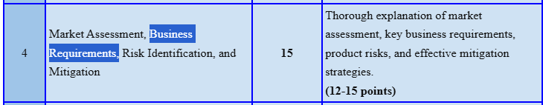
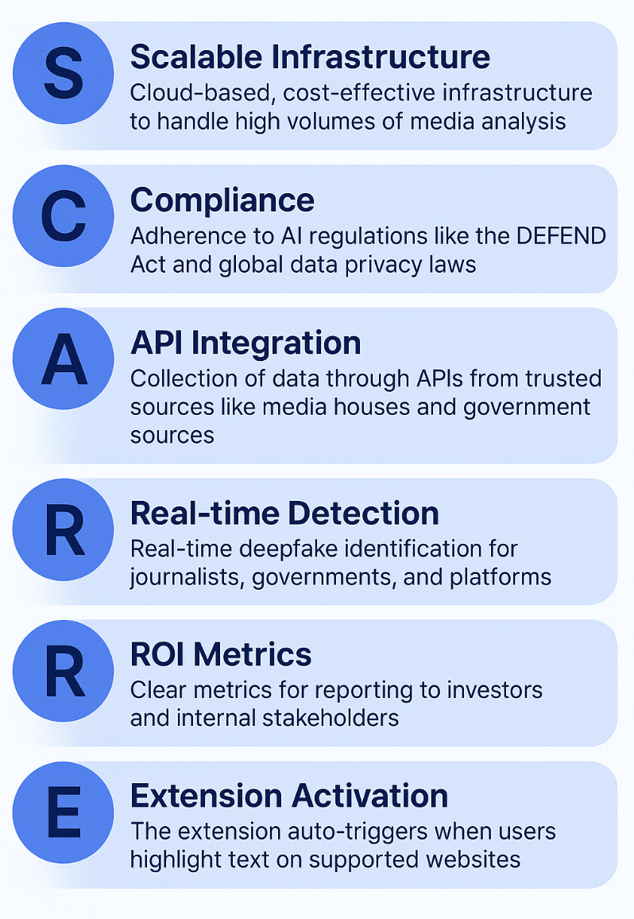
Key Business Requirements
Notes:
Kunal: these are the high-level needs and goals our product must meet to deliver value to our customers.
We simply aimed to answer the question: “What must this product achieve to be considered successful?”
And the answer?
-Scalable infrastructure (to manage large scale data operation),
-Compliance ( to comply with AI related laws),
- API integration (to collect data from reliable sources),
-Real-time detection (to detect media in real time),
- ROI metrics , and finally
-Extension activation (to highlight content seamlessly and get an answer prompt as to true/False)..process of loading and activating an extension when a specific event or condition occurs.
Just a major aim to provide extensions for easy access of the platform which will auto trigger when a particular text is selected without opening a different website.
@shivani- add another E in Scarr→ SCARRE- extension Activation: The extension must auto-trigger when users highlight text on supported websites. @shivani- change description of API to- collection of data through aPIs from trusted sources like media houses, government sources, etc)

Slide 7
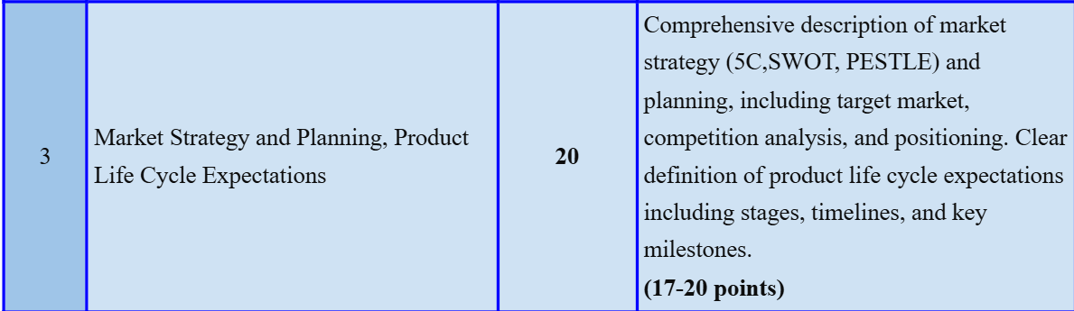
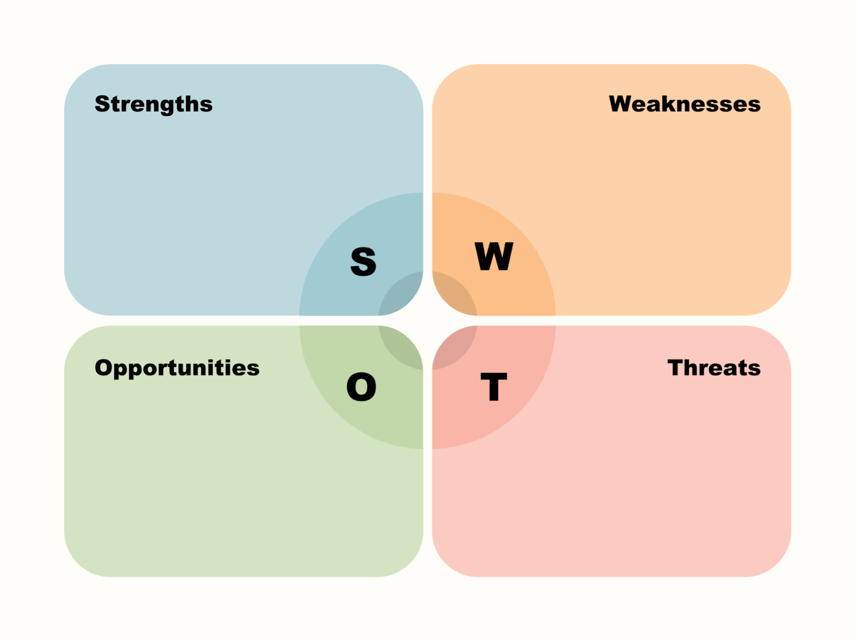
Market Strategy & Planning: SWOT Analysis
Comprehensive Media verification
Real-time authentication
Diverse Target Audience
Clear Value Proposition
Emphasis on User Experience
Unproven
Market Education
Accuracy – Continual improvements needed to reach near-perfect detection
Resource Limitations
Technical Complexity
High Demand to spot fake news and videos.
Competitors lack in accessibility, or user experience, which MythBuster.AI can improve.
Develop superior detection across all media
Serve diverse market segments
Rapid Deep-Fake industry evolution
Established Competitors
Users may doubt product effectiveness.
Evolving laws may impact development
Misuse of MythBuster.AI could improve DeepFake creation.
Notes:
Cade: Next we will look at our market strategy and planning, starting with a SWOT analysis. Our product is poised to enter a growing but complex new market, requiring careful planning for success.
In our SWOT we found our biggest strengths are the comprehensive media coverage we can offer, ranging from image and video to media story verification. Additionally, these verifications can be made in real-time. Our target audience is large; including everyday social media users, journalists, fact-checkers content creators, law enforcement and more. The value proposition is simple, Mythbuster AI will address concerns about misinformation and digital content authenticity. We want to provide a user experience that streamlines into everyday media usage.
Weaknesses to address include proving new product viability to customers. Education of our users on media authenticity will be a challenge. Accuracy will be a challenge due to the technical complexity of detection. As a startup in a new field, resources are limited and this all leads to a technically complex solution.
The good news is that there are many opportunities for this product. The market is growing and people are concerned about the authenticity of what they see. Mythbuster AI has a chance for a competitive market gap by combining deepfake and altered media identification with fact-checking capabilities. It is this streamlined “multimodal” capability that can set us apart. Additionally, we have an opportunity to create this platform with a tiered business model, tailoring offerings to best suite specific groups.
Some threats we foresee are rapid evolution of deep-fakes, requiring constant improvement to keep up. There are established competitors; these are tech giants like Google, Microsoft, and Meta with significant R&D power and resources. There are also specialized startups which are competing for aspects of our business. We will need to develop our product carefully with our multimodal model in order to offer more value to customers. However, by balancing these aspects of our SWOT, we have a vision for a product that can outperform competitors and offer true value to users.

Slide 8
Market Strategy & Planning: 5C Analysis
Company
Customers
Competitors
Collaborators
Climate
Internal strengths, weaknesses, resources, etc.
Customer needs, experiences, behaviors
Competition and their current market offerings
Potential partnerships; benefits and values
State of the market the product will be injected to
Strengths
Deepfake-focused
Multi-format detection
Specialize in real-time capability
Company aims for unbiased public trust
Weaknesses
New and unproven
Longer development timeline
Limited initial resources as a startup
Resources and Capabilities
Access to AI/Deepfake models for training
Access to news source databases
Target Customers
Social media users
News readers,
Content creators and enthusiasts
Customer Desires
Identify deep fakes
Identify misinformation
Detecting AI in news & creative media
Use the tool seamlessly in everyday tasks
Customer Behavior & Acquisition
Subscriptions, prefer low monthly costs
Premium models for latest tools
Communication & promotion directly through social media
Microsoft Video Authenticator
Microsoft’s resources
Detects subtle visual cues (fades, grayscale)
Focused on political content, not public use
Google DeepFake Protection
Google’s resources
Primarily research-driven
Not yet a commercial product
Facebook DeepFake Protection
Meta’s AI and resources
Trained using Meta’s own generative tools
Focused on facial deep fakes
Designed for public & businesses
Partnerships
Database partnerships with local news stations of an area provide cross verification of data
Stakeholders
Investors focused on deepfake protection can provide financial backing for development
Early partnerships with clients provides monetary investment and loyalty
Climate
Social media & reality are more politically divided than ever with misinformation spread
AI-generated content will become more challenging to identify
AI is constantly evolving
Social media is highly impacted by AI and misinformation
Evolving government regulations and AI policies
The technology landscape is changing allowing more potentially harmful AI uses
Notes:
This is the 5C analysis of our product which comprises of Company, Customers, Competitors, Collaborators and Climate. For instance, Company consists of its strengths weaknesses and capabilities as cade discusssed in the previous slide.
Customers, which majorly include the general public along with content creators and social media users. As we will discuss in more detail in the later slides, we will start with low cost subscriptions to gain trust and validation. We will also be advertising through our partnered social media to reach potential customers.
Moving on to Competitors, we have a couple well established ones and some startups but none provide what we do.
Our Collaborations would include buying API keys from trusted media sources.
And Finally the climate, like we discussed in the current vs future state of the market.

Slide 9
Market Strategy & Planning: PESTEL Analysis (USA)
Election Integrity: verify political content
Federal Initiatives: CISA
Bipartisan Support: Support from both parties
State-Level Variations: Have varied views
Political Polarization: Must remain neutral
National Security Concerns: Synthetic media
P
Media Investment: Adopting proof tech
Market Growth: $1.3 billion by 2027
Venture Capital: $15–30 million per deal in AI security startups
Corporate Demand: budgeting for digital content verification tools
Ad Industry Pressure: Must avoid fake content
Cost of Misinformation: $78B yearly in damage
E
Low Trust: 26% of Americans trust social media
Digital Literacy: Tech skills vary by group
Social Media: Most of US uses social media
Short-Form Video: verification more important
Exposure: 7 hours a day on digital media
Concern vs. Confidence: concern about deep-fakes; low confidence spotting them
S
5G & Broadband: support real-time verification
Mobile Platform Dominance: iOS and Android
Cloud Availability: Enable efficient processing
Platform Integration: APIs help integration
AI Research Proximity: Potential university R&D
Established Competitors: Need to stand out
T
High Energy Use: Sustainability issues for AI
Corporate ESG Pressure: Green tech solutions expected from corporations
Remote Work: Increases verification needs
Tech Industry Goals: Climate pledges shape expectations for eco-friendly partnerships
E
Federal Laws: Synthetic media labeling rules
State Rules: Varying deepfake laws
FTC Oversight: Standards for detection tools
Legal Liability: Demand for content verification
IP Protection: Patent laws protect new tech
Privacy Compliance: CCPA and privacy laws
L
Notes:
Cade: Our Pestel analysis starts with political factors. In particular, verification of election related content in media. Federal agencies have introduced initiatives that may aid our product. Development of fact-checking and verification programs have bipartisan support. There is variation in how this is dealt with but it is unanimously agreed in politics that this must be addressed.
Economically, there is significant media investment in fact checking technology. The market is expected to grow 1.3 billion dollars in the US by 2027 and there is investment potential for startups. There is demand in corporate sectors, the add industry, and more for the tools we can offer. Damages caused by misinformation in the US are estimated near 78 billion dollars per year.
Social factors influencing the US market include low trust in content and variation in “digital literacy.” Short form social media videos and high rates of social media usage have caused concern about identifying what is authentic on social media and other media encountered on a daily basis.
Technological factors include improved internet, supporting real time capability; a large mobile platform dominated by iOS and Android; and new cloud capabilities. APIs make for easier access to verification data and research into this field is becoming more relevant.
Environmental factors are important, including concern about the resources used by large data servers, AI computation, and cloud services. Corporations in tech are being pressured to become greener and climate pledges require more efficient usage of computational power.
Legally, misinformation, deepfakes, and altered media have complex federal laws, and various state laws. All of this means equally complex legal complication in creating detection tools. There is legal liability in content verification, patented technology, and of course privacy laws to navigate.
These factors must be considered in creating a marketable and robust product.
Political: Election Integrity: Need to verify political content for elections
Federal Initiatives: CISA combating election-related misinformation spread
Bipartisan Support: Support from both parties on reducing AI-generated false content
State-Level Variations: Have varied views on tech/privacy
Political Polarization: Programs must remain neutral to avoid accusations of partisan bias
National Security Concerns: Synthetic media is seen as a national security threat
Economic:
Media Investment: Major news outlets are adopting proof tech to boost credibility and attract advertisers
Market Growth: The US deepfake detection market projected to reach $1.3 billion by 2027
Venture Capital: $15–30 million per deal in AI security startups
Corporate Demand: Many Fortune 500 companies are budgeting for digital content verification tools
Ad Industry Pressure: Under pressure to avoid fake content
Cost of Misinformation: Misinformation expected to cost the US $78 billion each year in economic damage
Social:
Low Trust: Only 26% of Americans trust what’s on social media
Digital Literacy Gaps: Differences in tech skills by age, income, and education shape how tools need to be designed
Widespread Social Media Use: Most adults use platforms like YouTube, Facebook, and Instagram
Short-Form Video Boom: Rise in quick video content makes fast and accurate verification more important
Exposure: Americans spend 7 hours a day on digital media
Concern vs. Confidence: Many worry about deep-fakes, but don’t feel confident spotting them
Technological:
Strong 5G & Broadband: High-speed coverage supports real-time content verification
Mobile Platform Dominance: iOS and Android are 97% of users
Cloud Availability: Scalable cloud services from top providers enable efficient processing
Platform Integration: APIs from major platforms make integration technically feasible
AI Research Proximity: Potential university R&D partnerships
Established Competitors: Differentiation is needed to stand out from companies like Truepic and Deeptrace
Environmental:
High Energy Use: Data centers use about 2% of US electricity, raising sustainability issues for AI tools
Corporate ESG Pressure: Most large companies report on sustainability, expecting greener tech solutions
Remote Work Trends: Ongoing remote work boosts dependence on digital communication, increasing verification needs
Tech Industry Goals: Big tech's climate pledges shape expectations for eco-friendly partnerships
Legal:
Federal Laws: DEFEND Act requires labeling of synthetic media
State Rules: Varying deepfake laws in states affect compliance
Section 230 Debate: Possible reforms could change how platforms manage third-party content
FTC Oversight: Guidance sets standards for detection tools
Legal Liability: Rising legal risks for deepfake creators boost demand for verification
IP Protection: Patent laws protect products, difficult to navigate
Privacy Compliance: Tools must align with CCPA and other privacy laws

Slide 10
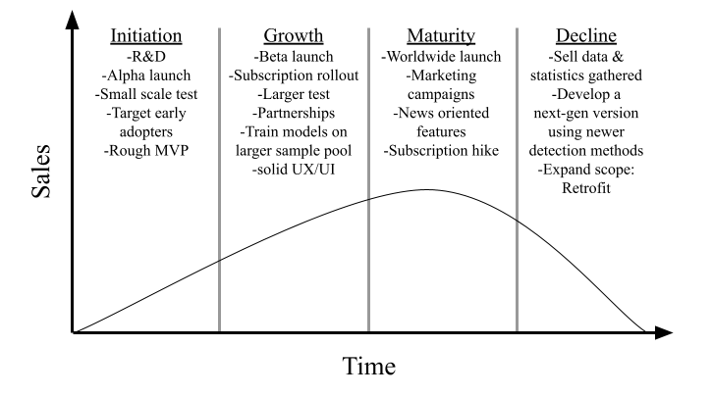
Overview of Product Life Cycle expectations
Notes:
Trent
We can see in the initiation phase that we will prioritize developing accuracy of the system and launching an Alpha, we will also target early adopts for them to test and start gathering data we will use to improve the model for the full release. Next, in the growth stage we will launch the beta and also rollout subscriptions, meaning this is when we will start making money more money, with a larger sample pool we can expand our AI’s accuracy. We will also now focus on features such as making a solid user interface that is professional to look at, with human factors considered. Next in the maturity phase we will launch worldwide, promotion & rolling out more news oriented features to subscribed users, we also will consider increasing the price of subscription. In the decline phase, we might sell data and demographics of users to other companies, lower our subscription price on this model, while developing a newer detection model using the data we gathered, while maybe expanding or changing our scope.
Automate support and backend systems to reduce operational costs

Slide 11
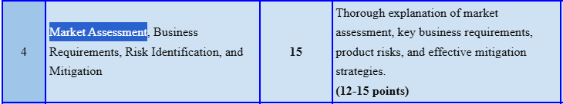
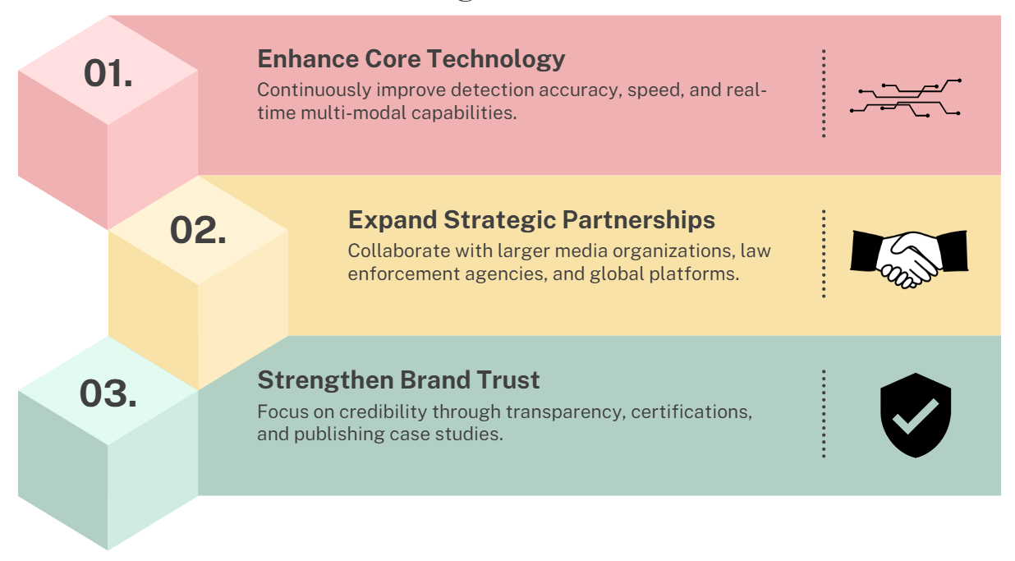
Market Assessment: Growth Stage
As more people discover and start using MythBuster.AI, we move into the growth stage
The goal is to get more users, both individuals and companies, to rely on MythBuster.AI.
Notes:
Fahad
As our product enters the growth stage, our focus shifts to scaling what we’ve built and making a bigger impact.
In the growth stage, we’re focusing on three key areas: enhancing technology, building partnerships, and earning trust.
Enhancing technology. That means continuing to improve how fast and accurately we detect fake content — especially across different formats like images, videos, and audio. As misinformation spreads fast, real-time performance becomes essential.
Next, we plan to expand strategic partnerships. By working with major media outlets, law enforcement, and global tech platforms, we can extend our reach and integrate MythBuster.AI into critical workflows where trust really matters.
Finally, we’re focused on strengthening brand trust. That involves being transparent about how our system works, earning certifications, and sharing real-world case studies that show our results - because people need to feel confident that our platform is reliable and objective.
Altogether, these focus areas will help us expand our user base — not just individuals, but also companies and institutions — who rely on our product to separate truth from misinformation.

Slide 12
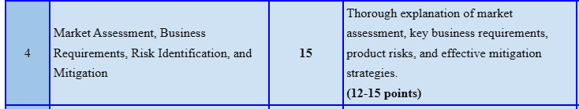
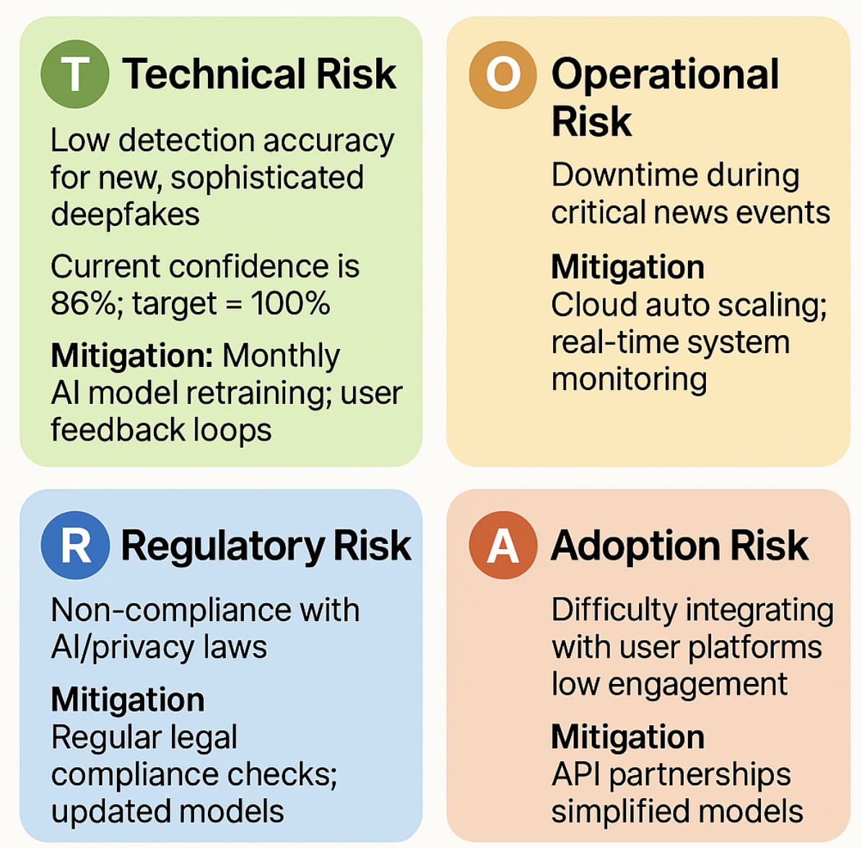
Product Risk Identification
Notes:
Abhishek
Technical Risk
Risk: New, AI-generated deepfakes (e.g., hyper-realistic political speeches or fraud videos) evolve faster than detection models, leading to missed fakes.
Mitigation: More Frequent retraining of AI models using adversarial datasets (simulated advanced deepfakes) and integrating real-time feedback from users (e.g., journalists flagging suspicious content). Regulatory Risk
Risk: Failing to comply with laws like Airprivacy (e.g., data privacy, AI bias) could result in fines or bans.
Mitigation: Regular legal audits to align with regulations and updating AI models to remove biases or unethical detection patterns. Operational Risk
Risk: Server crashes during high-traffic events (e.g., elections) erode user trust and credibility.
Mitigation: Employing cloud tools (e.g., AWS) to handle traffic spikes and Real time monitoring .
Adoption Risk
Risk:Users won’t use the tool if it’s hard to connect to platforms (like TikTok/Instagram) or confusing to operate.
Mitigation: Make it simple is the key one-click onboarding (e.g., drag-and-drop media verification), and web extentions and Trusted API Partnerships.

Slide 13
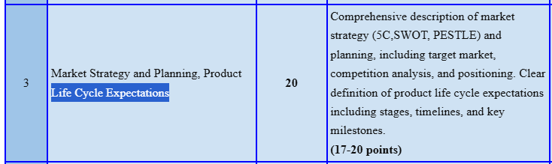
Lifecycle Phase Risks
🚀 Launch
MVP bugs, delayed API integration
🛡️ Mitigate: Beta testing, phased rollout
📈 Growth
Tech giant competition, Customer Retention
🛡️ Mitigate: Loyalty programs + feedback-driven updates, rapid AI updates
🏆 Maturity
Complacency, rising R&D costs
🛡️Mitigate: Tiered pricing, reinvestment
🔄 Update
Tech obsolescence, user backlash
🛡️ Mitigate: Modular redesign, user co-design
Notes:
Abhishek
Launch Phase Risks:
Early versions of MythBuster.AI may contain undetected flaws (e.g., mislabeling real content as fake or missing subtle deepfakes), damaging user trust.
Mitigation:
Rigorous beta testing with journalists and fact-checkers to catch bugs.
Phased Rollouts, solving bugs stagewise based on feedbacks
Growth Phase Risks
Users switch to competitors due to better features/pricing, Google/Meta launch free tools, undercutting market share.
Mitigate:
Loyalty Programs + User Feedback-Driven Features Rapid AI Updates
Maturity Phase Risks
As MythBuster.AI becomes established, the team might slow innovation, letting newer tools surpass its detection accuracy. Meanwhile, costs to train cutting-edge AI models (e.g., GPT-5-level detectors) could strain budgets.
Mitigation:
Tiered pricing (Fee for more advance feature, premium for enterprises) to fund R&D.
Reinvest 30% of profits into adversarial training (testing against newest deepfakes).
Update Phase Risks
New AI tools (e.g., quantum-generated deepfakes) could render current detection methods obsolete. Major UI/algorithm changes might frustrate loyal users accustomed to the existing workflow.
Mitigation:
Modular updates: Roll out improvements in stages (e.g., audio detection upgrades first).
User feedback loops: Let power users vote on features via in-app surveys.

Slide 14
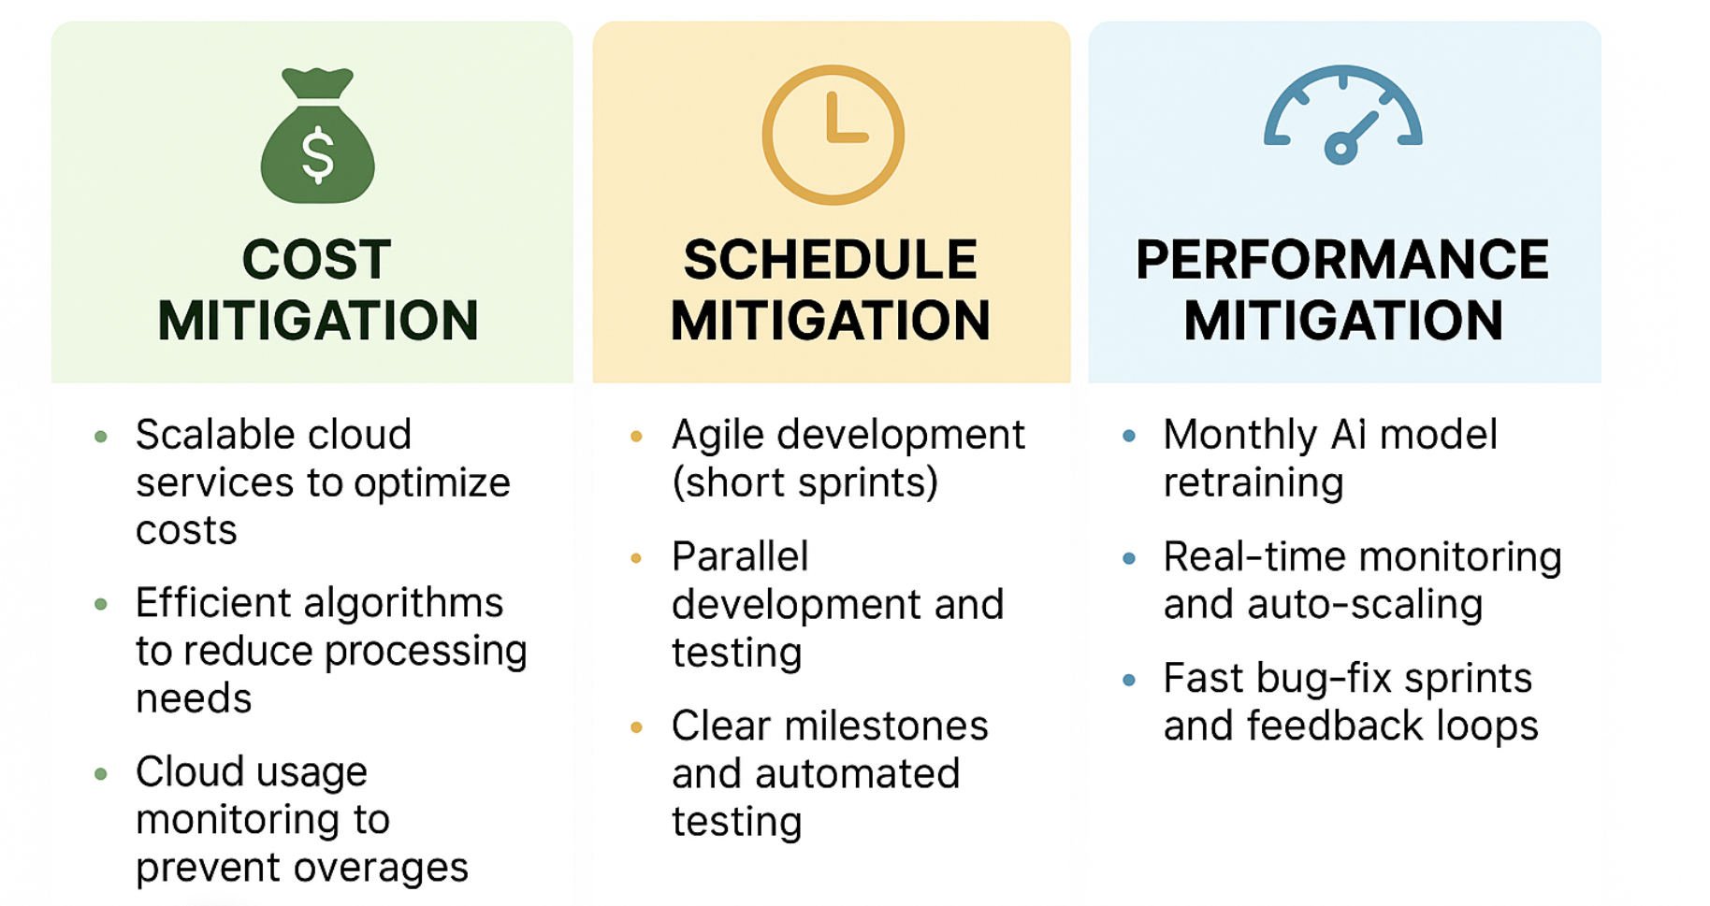
Cost, Schedule & Performance Mitigation
Notes:
Shivani- Our mitigation strategy will avoid delays in updates and unnecessary spending. We’ll lean on scalable cloud services so we only pay for capacity we need at that point of time. We will design the algorithms in such a way that our processors will handle them without the need for upgrades.Cloud usage monitor will alert us before we hit cost overruns.
To be on the top of the schedule, We will use agile development method to ensure smooth go-live and parallel development and testing to launch multiple features at the same time. From the feedback of the users, we will retrain our AI model so that it gives accurate results. Cloud will automatically scale up or down depending on the use. We will use feedback loops to fix bugs in the application. So that when it is reported, we will debug and then test and when application is refreshed, it is implemented. These strategies will save money, time and will improve the performance of the website.

Slide 15
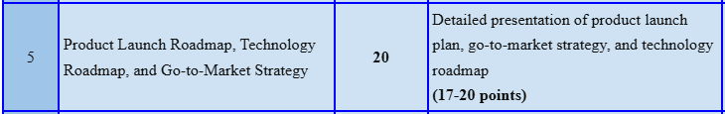
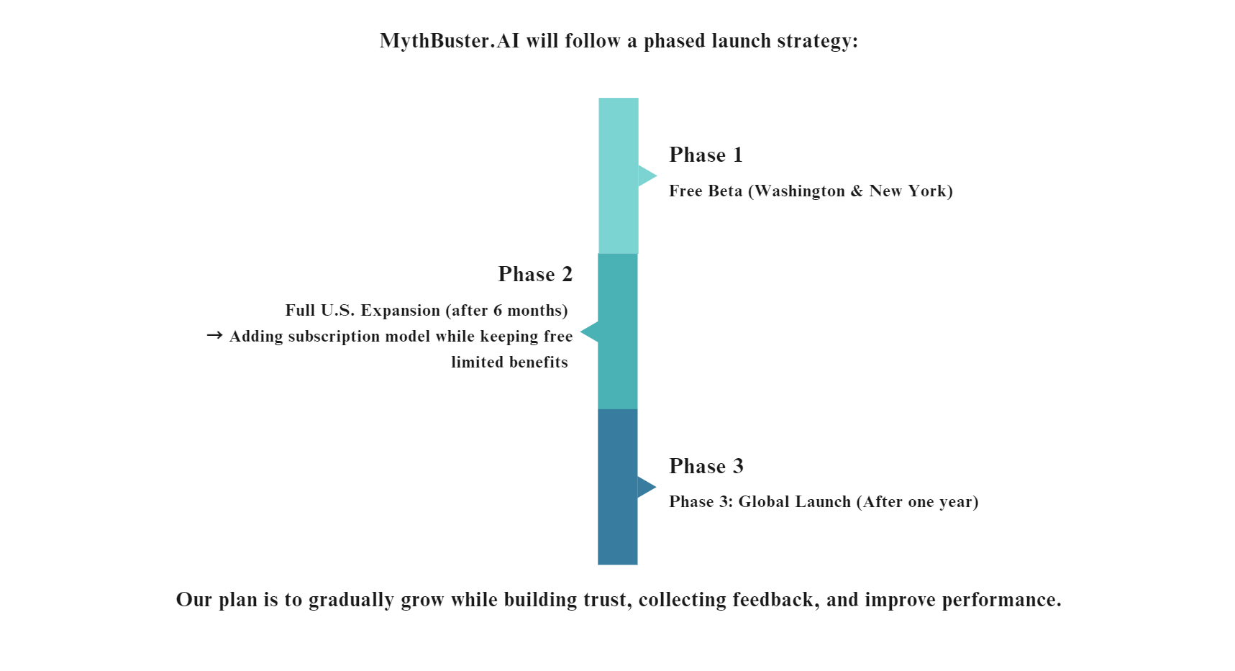
Product Launch Roadmap
Notes:
Hiba

Slide 16
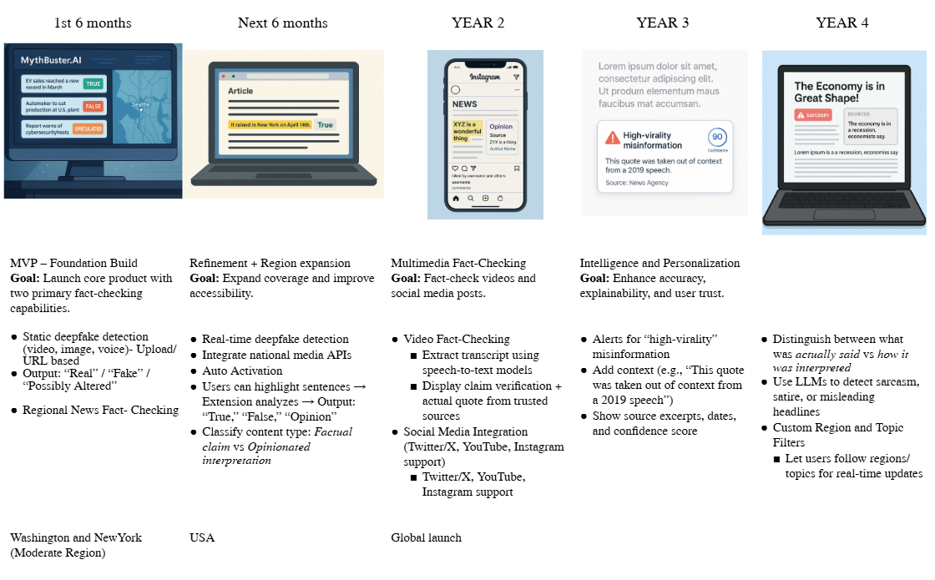
Product Technology Roadmap
Notes:
Hiba

Slide 17
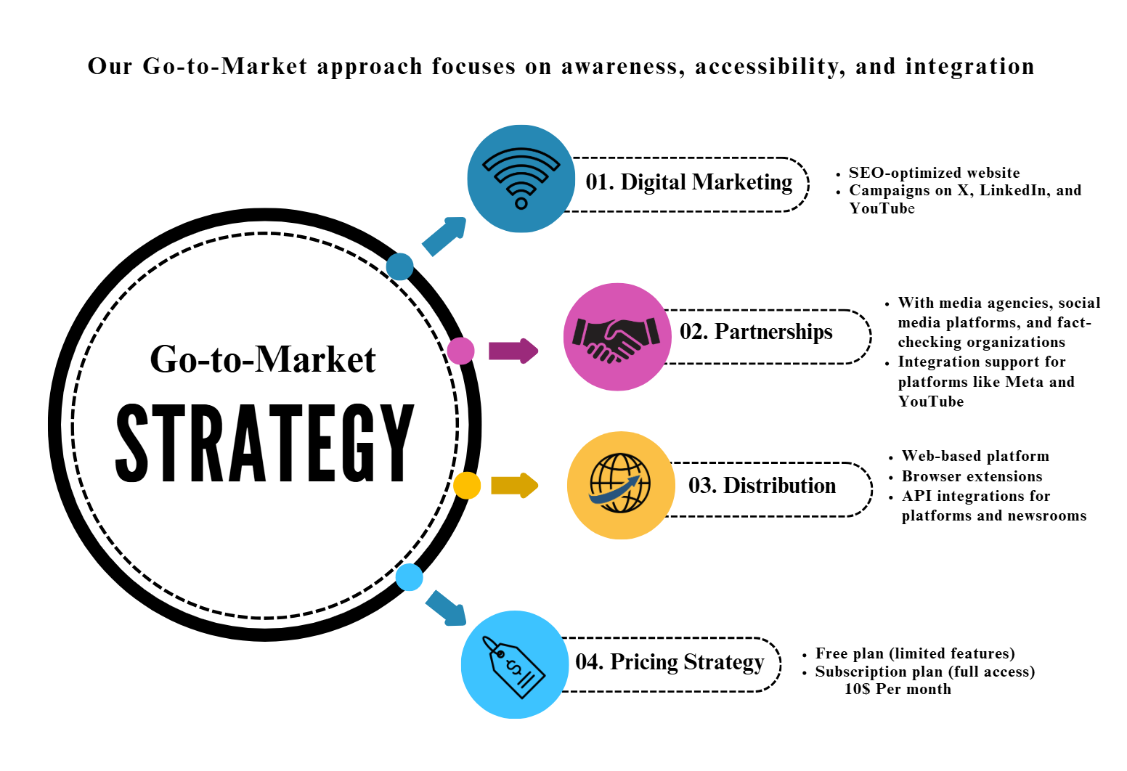
Notes:
Kunal
The approach prioritizes awareness, accessibility, and integration to ensure the product reaches its target audience effectively.
1. Digital Marketing
Goal: Build awareness and drive traffic.
How:
Launching a SEO-optimized website for visibility on search engines.
Running digital ad campaigns on platforms like X (formerly Twitter), LinkedIn, and YouTube to reach relevant users and professionals.
2. Partnerships
Goal: Expand credibility and reach through strategic collaborations.
How:
Partnering with media agencies, social media platforms, and fact-checking organizations to build trust and enhance content authenticity.
Enabling integration with major platforms like Meta (Facebook/Instagram) and YouTube for seamless content deployment or verification.
3. Distribution
Goal: Ensure easy access and wide availability of the product.
How:
Offering a web-based platform that users can access directly.
Providing browser extensions for quick access and functionality.
Developing API integrations so that third-party platforms and newsrooms can embed the tool in their workflows.
4. Pricing Strategy
Goal: Attract users with flexibility and scale monetization.
How:
A Free Plan that offers limited features to allow users to try the product.
A Subscription Plan priced at $10/month for full access, making it affordable and scalable for professionals or organizations.

Slide 18
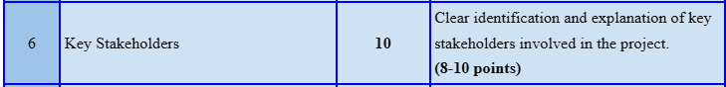
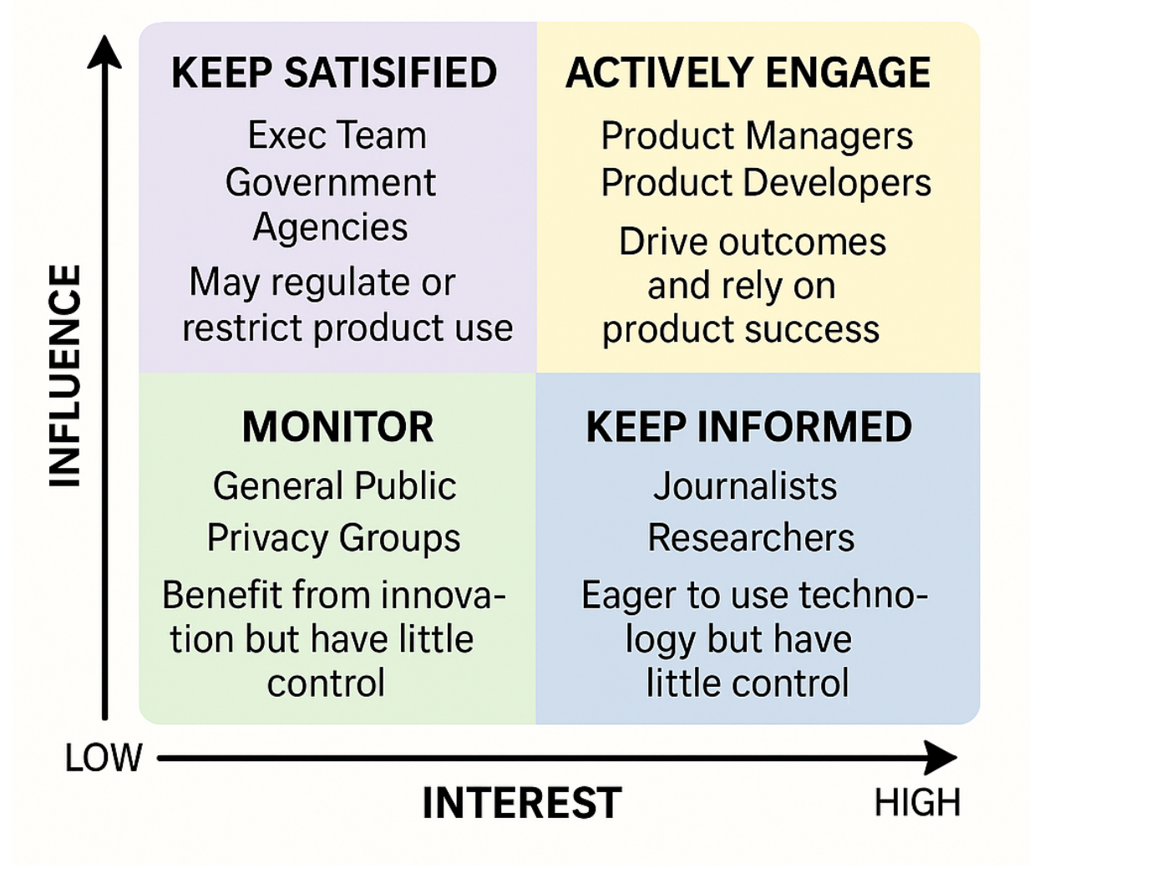
Key Stakeholders Matrix
HIGH
HIGH
Notes:
Shivani - This product would have multiple internal and external stakeholders. We would monitor the general public and privacy orgs feedback and publish blog posts addressing privacy safety. We would keep Journalists and researchers informed through webinars and updated FAQs. Regulators and Ethical Organisations will get an early access to audit reports and we will maintain algorithmic transparency. We would have daily standups with the Product Developers and Managers. We would have a rapid escalation for issues.

Slide 19
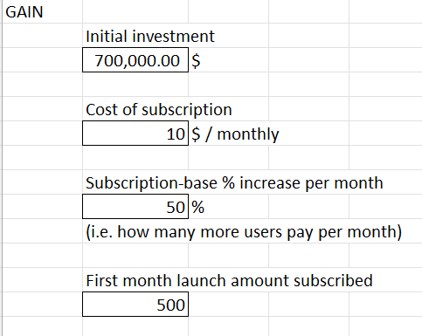
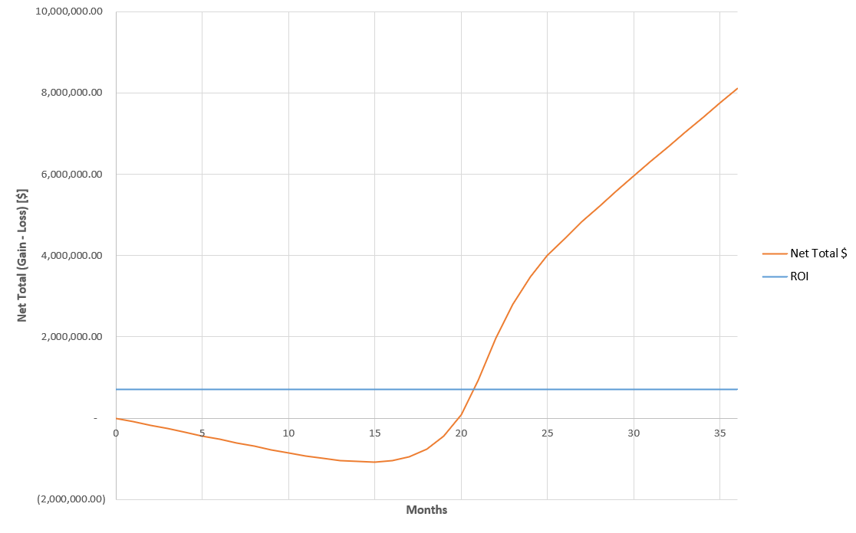
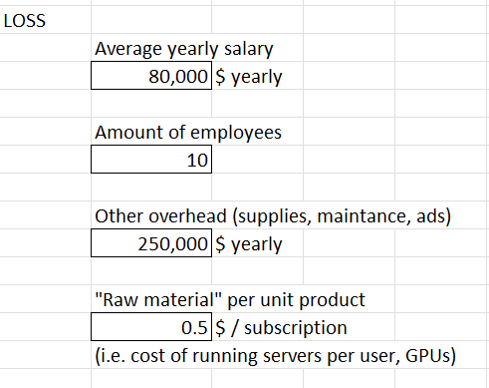
Market Growth & Cash Flow
GAIN
LOSS
Notes:
Trent
One of our key business requirements was ensuring return on investment and any potential investors, so we ran this simulation to verify the realism and determine an initial investment to get the product rolling

Slide 20
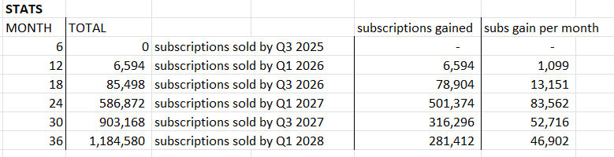
Return on Investment & Financial Viability
Subs sale starts Q3 2025 (8 months) (after beta)
ROI break even on Q3 2026 (193,620 subscriptions)
(20 months)
1,057% increase on ROI after 3 years (Q1 2028)
($8.1m net total gain, @1,184,580 subscriptions)
Notes:
Trent

Slide 21
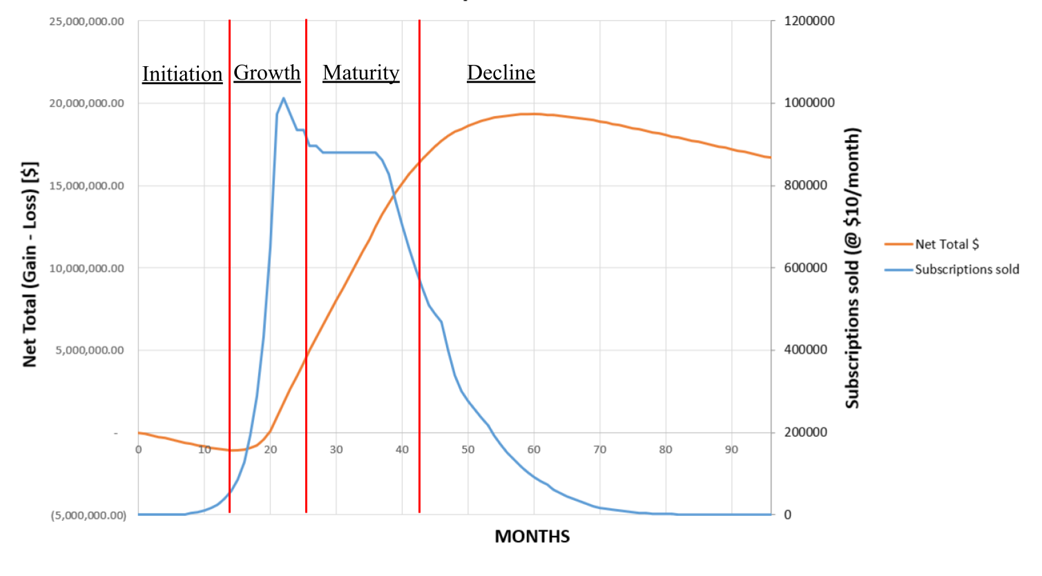
Product Life Cycle Prediction / Simulation

Slide 22
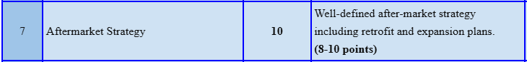
After Market Strategy (retrofit and expansion)
Keep loyal subscribers happy & engaged; develop new features & support
Retrofit: Decreasing price of subscription or creating cheaper options
STEPS:
Installed Base Need: Log majority demographic of subscribers
Market Definition: Provide support & maintenance for this demographic (to retain)
Customer Definition: Retrofit & taylor support, provide public FAQ (paid users)
Product Definition: Feature updates & online customer support (paid users)
System Definition: Open new markets & support loyal subscribed users
Notes:
Trent Retrofit means modifying or upgrading an existing product or system

Slide 23
Retrofit (Alternate pricing) & effects on ROI
Subscription Investment: $700,000
Price $/month 3yr net value $ ROI % increase after 3 years
6.00 3.36m 380.74%
8.00 5.7m 719.19%
10.00 8.1m 1,057%
11.00 9.28m 1,227%
12.00 10.47m 1,396%
13.00 11.66m 1,565%
14.00 12.86m 1,734%
15.00 14m 1,903%
17.00 16.3m 2,242%
20.00 19.95m 2,749%

Slide 24

CONCLUSION
Thank you for your attention
“One click to certainty”
Notes:
“MythBuster.AI isn’t just a tool, it’s the foundation for digital truth in an AI-driven world.
Now is the time to invest in the technology that keeps truth ahead of manipulation.”

Slide 25
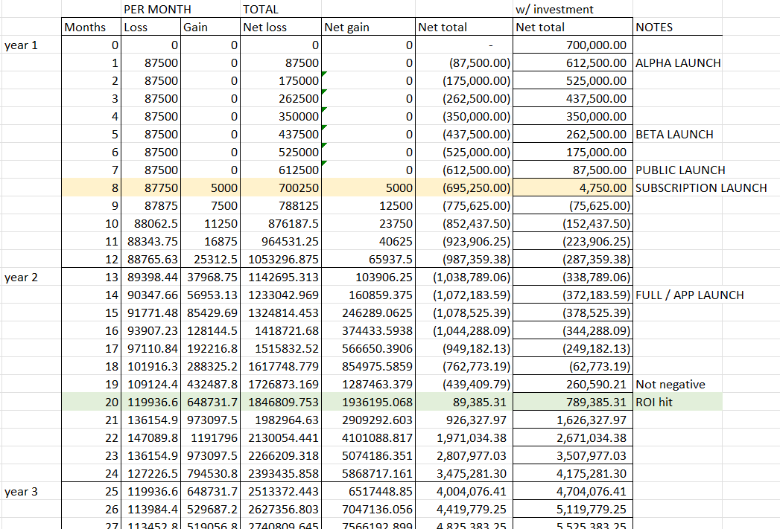
BACKUP SLIDES (if needed)
More detailed ROI
//Cost roadmap
(does not include year 3)

Slide 26
Product Risks (extra)
⚙️Technical
False positives/negatives
AI vs. deepfake arms race
Cloud dependency (AWS/Google)
🛡️ Mitigate: Hybrid cloud, rigorous testing, R&D sprints
💹Market
Competition (Google/Microsoft)
Low user adoption/awareness
Economic downturns
🛡️ Mitigate: Freemium tiers, influencer partnerships, B2B contracts
⚖️Regulatory
GDPR/CCPA compliance
Ethical bias accusations
🛡️ Mitigate: Legal advisory board, transparent AI audits
📉Reputation
High-profile failures (e.g., elections)
🛡️ Mitigate: Proactive alerts, accuracy transparency
Notes:
N/A

